Slide 1

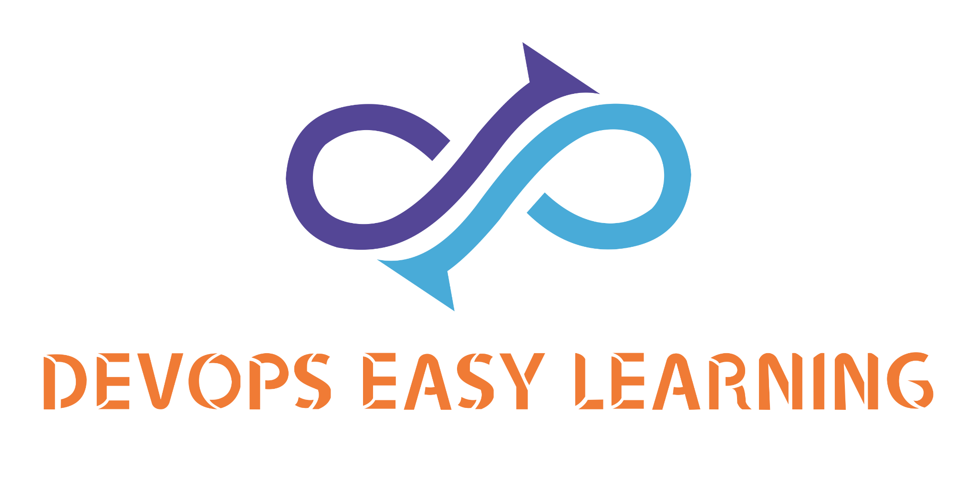
The weather App
Name: Tarzan
Deployment strategie: Docker-compose.

Slide 2
GOAL
Deploy Tarzan microservice using Docker-compose.

Slide 3

INFO
Customer Name: The Weather Channel

Slide 4
INFO
IN their effort to make customers have weather info around the globe at their fingertips, The Weather Channel have contracted EK TECH SOFTWARE SOLUTION to build an application called Tarzan accessible on the web, phones,tablets or any other portable electronic devices.

Slide 5
INFO
Tarzan is made of 5 services
a- UI
b- auth
c- weather
d- db
e- redis
UI
auth
weather
db
redis
Tarzan

Slide 6
INFO
UI:
allow customers to access the application on the browser
Auth:
Allow customers login into the app
Weather: contain all weathers data
Db:
Store user credentials
Redis:
Store user session caching data
Tarzan

Slide 7
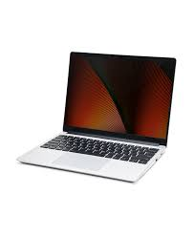

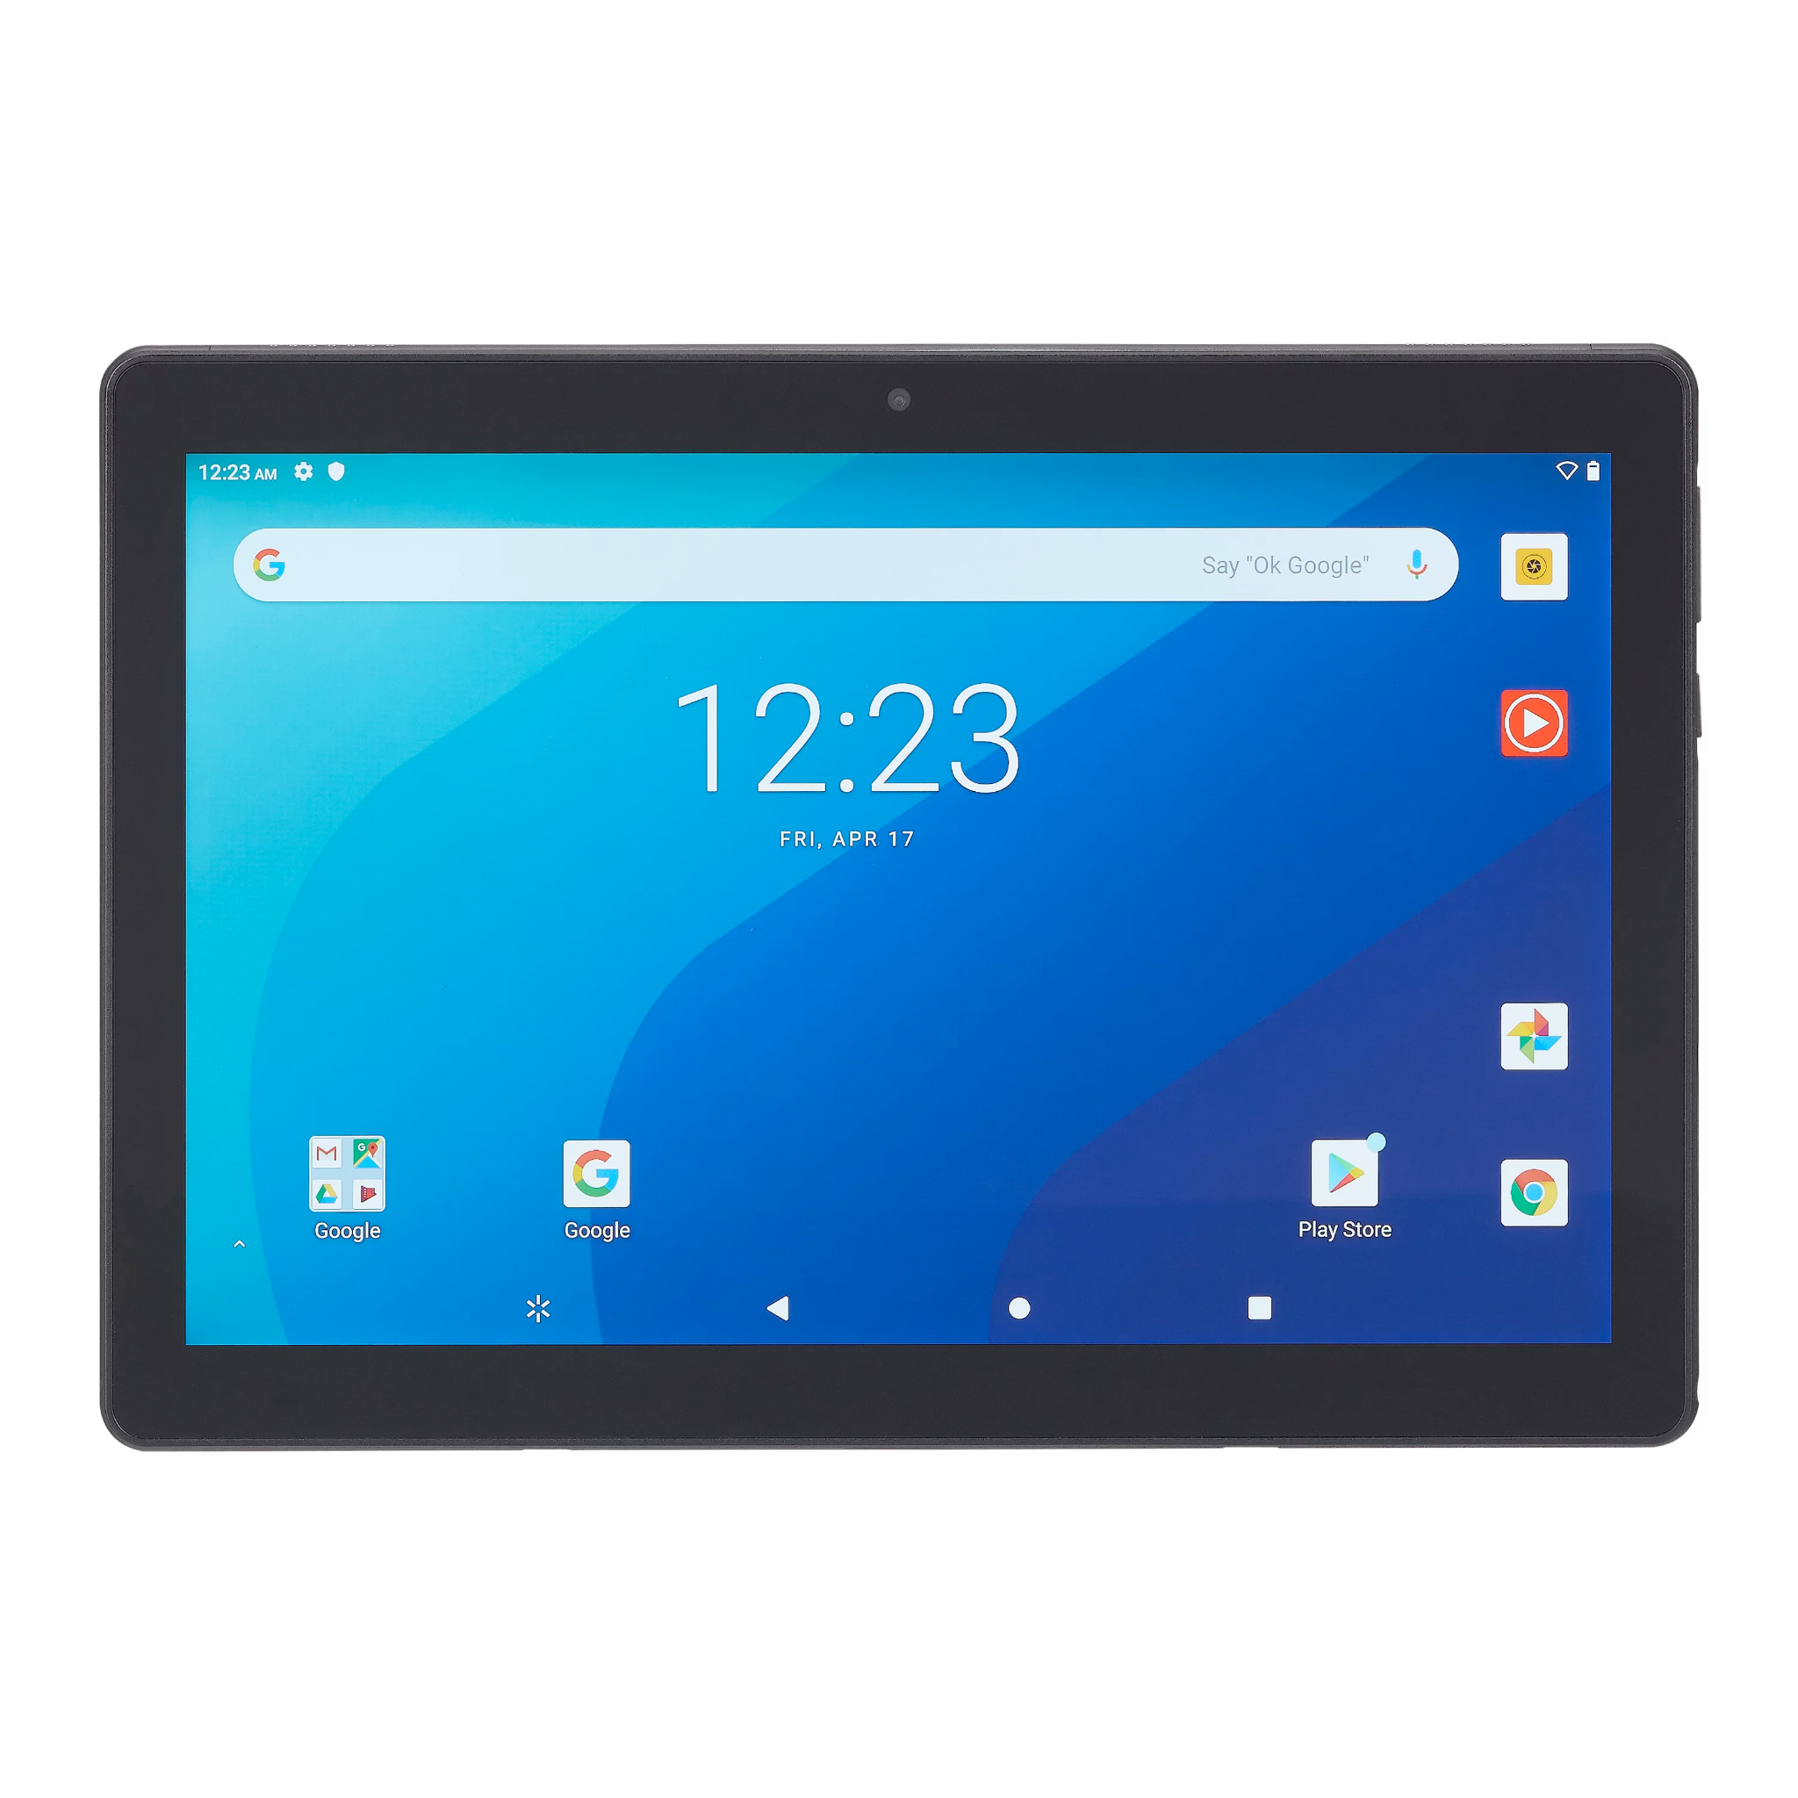
INFO:starting sequence
Db:
Store user credentials
Redis:
Store user session caching data
Weather: contain all weathers data
1
4
UI:
allow customers to access the application on the browser
2
Auth:
Allow customers login into the app
3
5
www.tarzan.com

Slide 8
INFO
Base-image:
devopseasylearning/tarzan-ui:v0.0.1
devopseasylearning/tarzan-auth:v0.0.1
devopseasylearning/tarzan-weather:v0.0.1
redis
devopseasylearning/tarzan-db:v0.0.1

Slide 9
INFO
Variables for UI service:
AUTH_HOST= auth
AUTH_PORT=8080
WEATHER_HOST= weather
WEATHER_PORT= 5000
REDIS_USER=redis
REDIS_PASSWORD=redis
Variables for Auth service:
DB_HOST= db
DB_PASSWORD= my-secret-pw
Variables for db service:
MYSQL_ROOT_PASSWORD= my-secret-pw
Variables for Weather service:
APIKEY = ecbc396f46mshb65cbb1f82cf334p1fcc87jsna5e962a3c542
Variables for redis service:
REDIS_USER=redis
REDIS_PASSWORD=redis

Slide 10
INFO
Ports for UI service:
3000

Slide 11


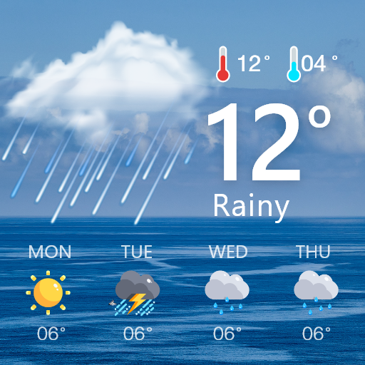
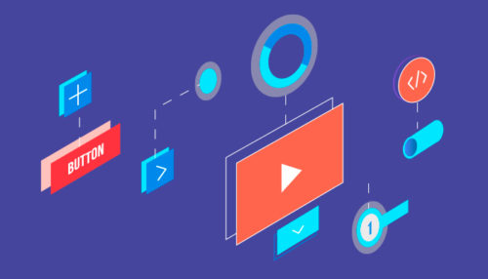
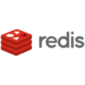

INFO:info flow
UI
Weather
Auth
Redis
db

Slide 12
Take notes here
Take node here

Slide 13
List all issues encounter on this project here

Slide 14
Explain this project in your own words

Slide 15


Slide 16
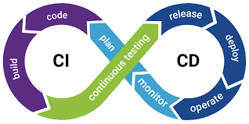

Slide 17
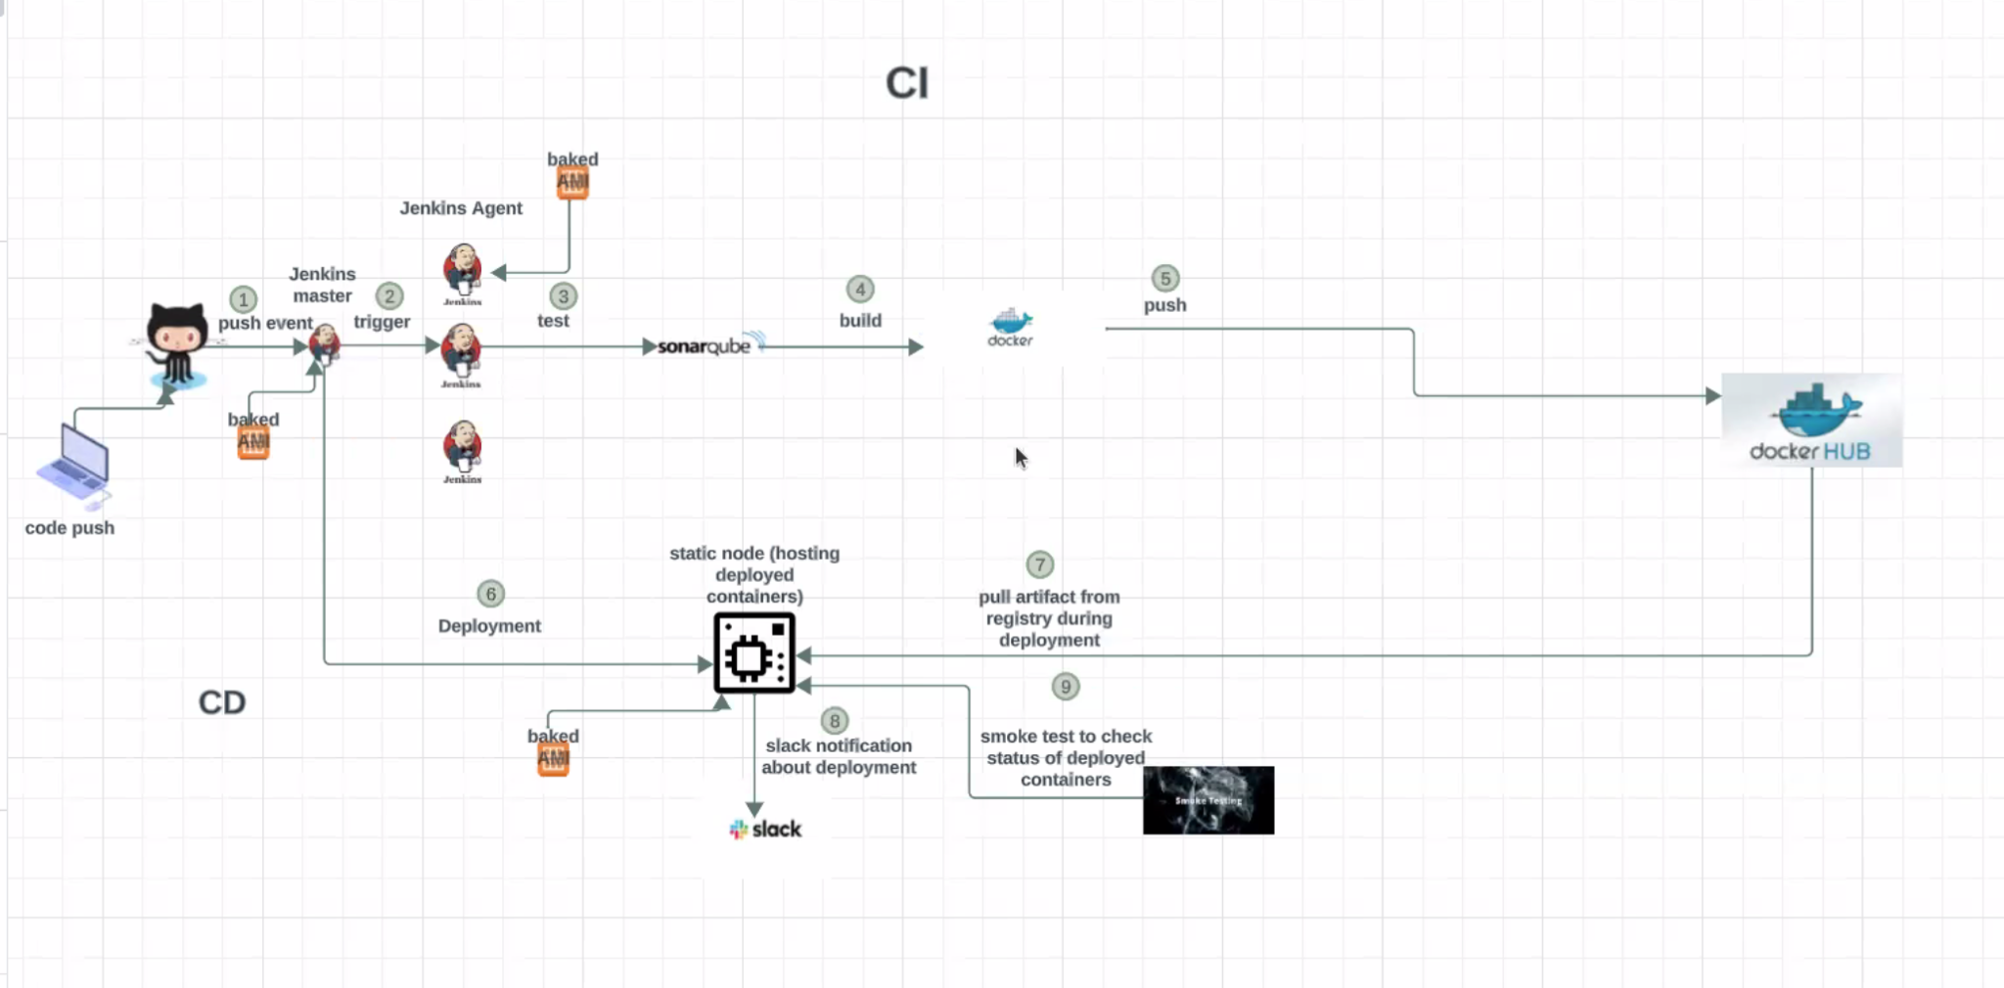

Slide 18
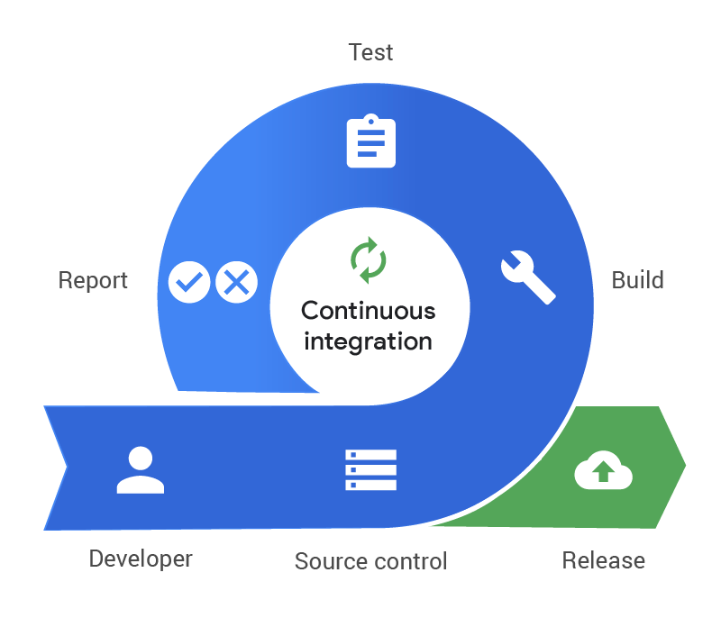
A push event is created triggered by a merge request from github and Jenkins master is Notified
1
Jenkins Master use EC2 plugin and the baked AMI to provision a dynamic agent based on the agent label specified on the Jenkinsfile
2
Jenkins launch dynamic docker agents to build (only binaries) and test (static test only) the code base on the language
When the static test and build pass, Jenkins launch a sonar-scanner docker agent to scan the code
The scan result is sent to sonarqube UI to compare with quality gate a PASS/FAIL, a decision is taken but only available on sonarqube UI
Jenkins use the built in function “Wait For Quality Gate” to pull the PASS/FAIL result from SonarQube UI, if the result is marked as failure, Jenkins terminate the build and the build result is sent to Slack, If the build pass jenkins will continue to run the pipeline.
3

Slide 19
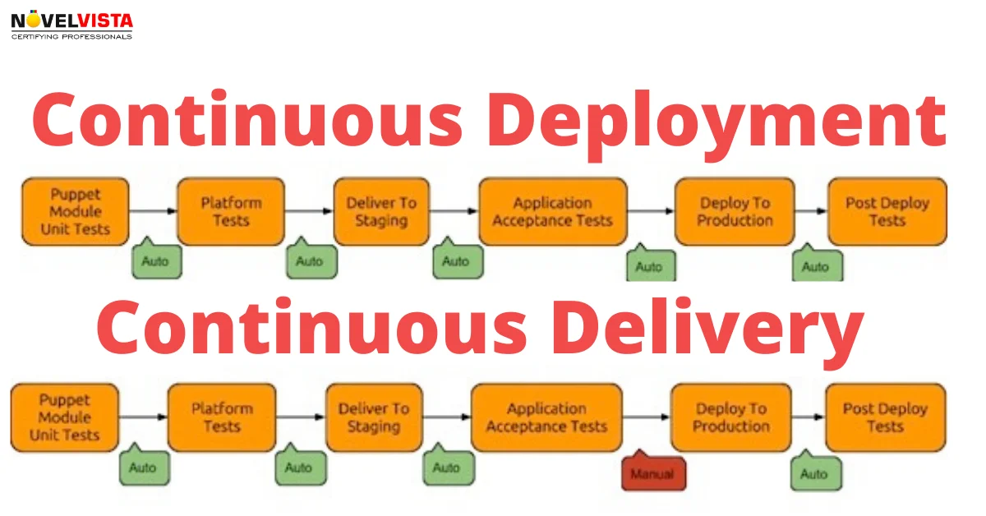
Jenkins invoke Docker to build all images using Dockerfiles present on the repo
4
Jenkins push docker images to DockerHub if the commit or target branch is develop
5
6
If the commit or target branch is develop:
A- Jenkins connect to an available static agent matching the label indicated on the Jenkinsfile
B- Jenkins create the docker-compose.yml file with all instructions about the deployment.

Slide 20
The Jenkins static agent read the docker-compose file and pull all required images
7
Jenkins announce a deployment on slack with a wait time
8
A- Jenkins deploy the application
B- Jenkins check if all containers are running (Jenkins will mark the build as failure if one or more containers are not in running state)
C- Jenkins run a smoke test to check if the application is available on the browser and that the login page populate
D- Jenkins notify the build status on Slack
9

Slide 21

Question

